Slide 1

Receptive Field, and Brightness Contrast
CAP 5738 Data Visualization
Spring 2018
Dr. Sayeed S. Alam

Slide 2

Today’s Visualization
Source: https://redd.it/7tkl50

Slide 3
Neurons
Neurons are the basic circuits of information processing in the brain.
In some respects they are like transistors, only much more complex.
Like the digital circuits of a computer, neurons respond with discrete pulses of electricity.
However, unlike transistors, neurons are connected to hundreds and sometimes thousands of other neurons

Slide 4
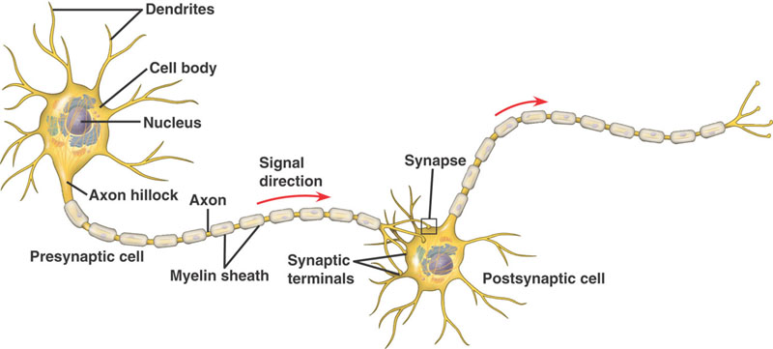
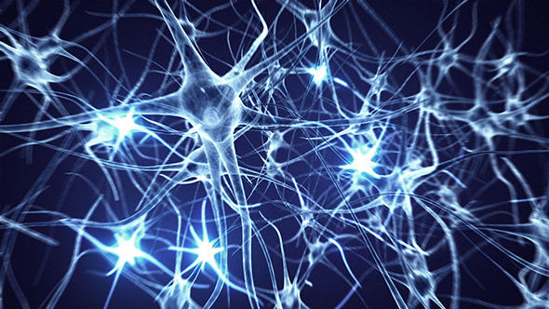
Neurons

Slide 5
Neurons
Much of our knowledge about the behavior of neurons comes from single-cell recording techniques whereby a tiny microelectrode is actually inserted into a cell and the cell’s electrical activity is monitored.
Most neurons are constantly active, emitting pulses of electricity through connections with other cells.
Depending on the input, the rate of firing can be increased or decreased as the neuron is excited or inhibited.
Neuroscientists often set up amplifiers and loudspeakers in their laboratories so that they can hear the activity of cells that are being probed.

Slide 6
Neural Processes in the Eye
There is considerable neural processing of information in the eye itself.
Several layers of cells in the eye culminate in retinal ganglion cells.
These ganglion cells send information through the optic nerve via a way station called the lateral geniculate nucleus, on to the primary visual processing areas at the back of the brain

Slide 7
Neural Processes in the Eye

Slide 8
Receptive Field
The receptive field of a cell is the visual area over which a cell responds to light.
This means that patterns of light falling on the retina influence the way the neuron responds, even though it may be many synapses removed from receptors.
Retinal ganglion cells are organized with circular receptive fields, and they can be either on-center or off-center.
When the cell is stimulated outside of the center of its field, it emits pulses at a lower-than-normal rate and is said to be inhibited.

Slide 9
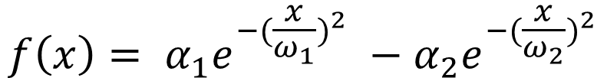
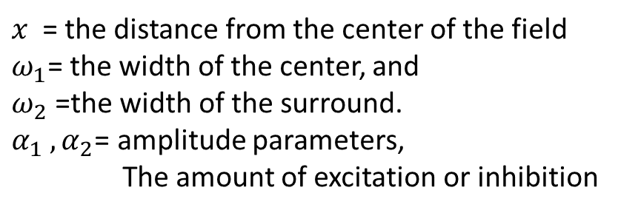
Receptive Field- DOG Function
Difference of Gaussian model (DOG)
$$f\left(x\right)= α_{1}e^{−{(\frac{x}{ω_{1}})}^{2}} −α_{2}e^{−{(\frac{x}{ω_{2}})}^{2}}$$
$x$ = the distance from the center of the field
$ω_{1}$= the width of the center, and
$ω_{2}$ =the width of the surround.
$α_{1}$ ${, α}_{2}$= amplitude parameters,
The amount of excitation or inhibition

Slide 10
Hermann Grid illusion

Slide 11
Simultaneous Brightness Contrast
The term simultaneous brightness contrast is used to explain the general effect whereby a gray patch placed on a dark background looks lighter than the same gray patch on a light background.

Slide 12
Simultaneous Brightness Contrast

Slide 13
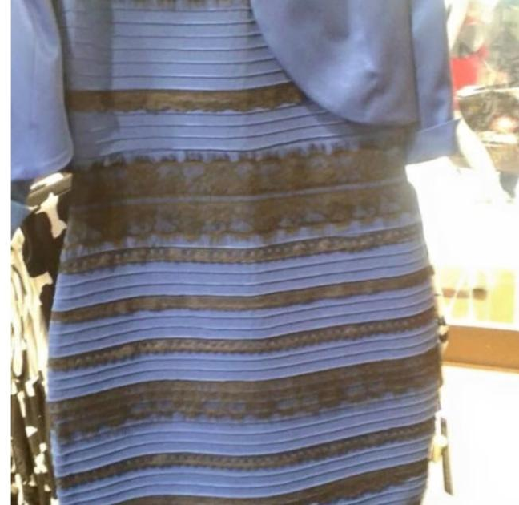
Simultaneous Brightness Contrast
Black-Blue
Or
White-Gold?

Slide 14
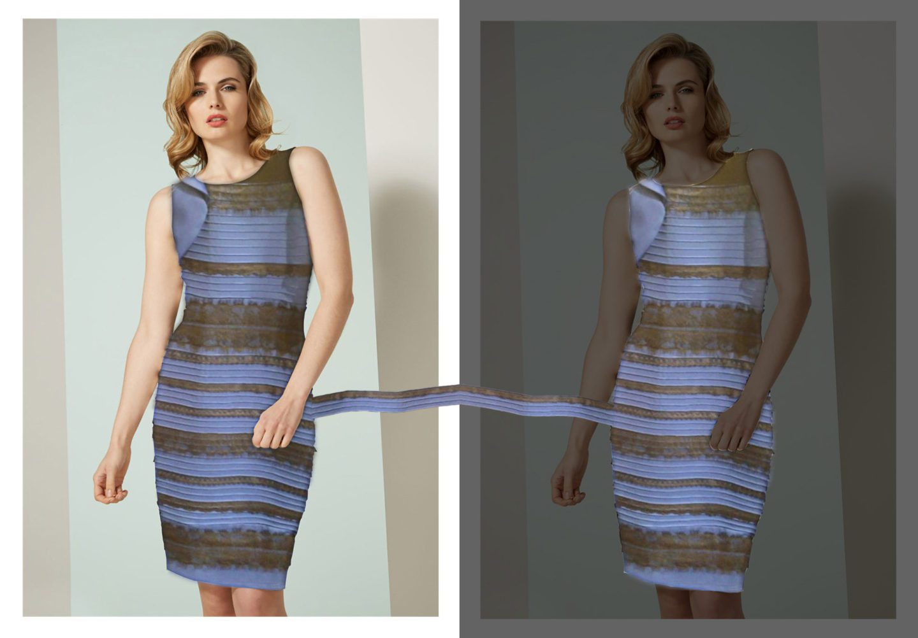
Simultaneous Brightness Contrast

Slide 15

Mach Band and Chevreul Illusion
Mach Band: At the point where a uniform area meets a luminance
ramp, a bright band is seen.
Chevreul Illusion: The bands appear darker at one edge than
at the other, even though they are uniform.

Slide 16
Edge Enhancement
Lateral inhibition can be considered the first stage of an edge detection process that signals the positions and contrasts of edges in the environment.
One of the consequences is that pseudoedges can be created; two areas that physically have the same lightness can be made to look different by having an edge between them that shades off gradually to the two sides.
Cornsweet effect: The brain does perceptual interpolation so that the entire central region appears lighter than surrounding regions.

Slide 17
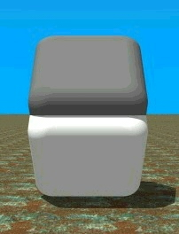
The Cornsweet effect

Slide 18
Edge Enhancement

Slide 19
Thank You

